Slide 1
SwiftFest RAY-20-OFF

Slide 2
for developers
@ray_deck

Slide 3
react-native-swift react-native-swift-cli react-native-coreml react-native-pods react-native-ios-setfamily react-native-appicons react-native-launchimages react-native-setdevteam react-native-xcode

Slide 4
facebook 2015

Slide 5
JavaScript As Orchestrator

Slide 6
RCTRootView
View
JavascriptCore
RCTBridge
Fetch
Animation

Slide 7
> yarn global add react-native-cli > react-native init <myprojectname> > cd <myprojectname> > code . > react-native run-ios

Slide 8
Rapid Reloading Code as Asset React

Slide 9
react-native link 2016

Slide 10
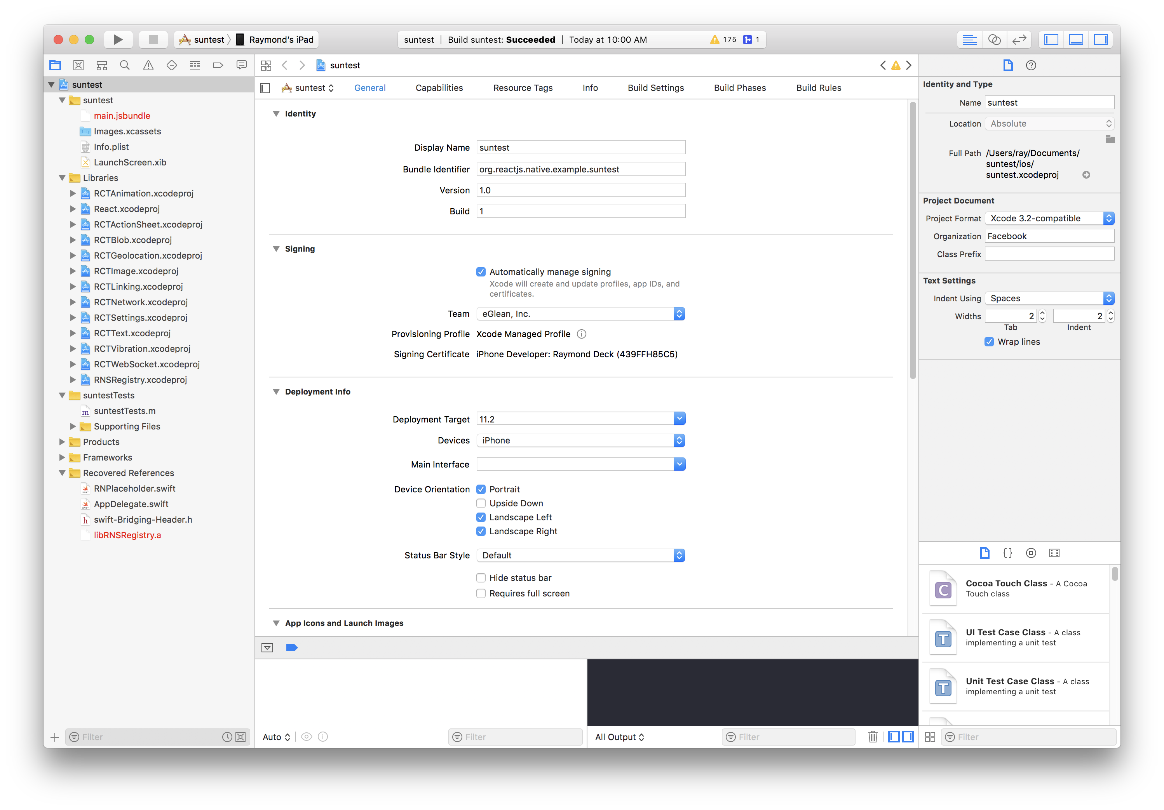

Slide 11
RCTRootView
RCTEventEmitter
JavascriptCore
RCTBridge
RCTViewManager
RCTBridgeModule

Slide 12
#import <React/RCTViewManager.h>
#import <React/RCTEventEmitter.h>
#import <React/RCTBridgeModule.h>
@interface RCT_EXTERN_MODULE(RNSBoston, RCTEventEmitter)
RCT_EXTERN_METHOD(demo:(NSString *)message success:(RCTPromiseResolveBlock)success reject:(RCTPromiseRejectBlock)reject);
RCT_EXTERN_METHOD(delayedSend:(NSString *)message ms:(NSInteger)ms);
@end
@interface RCT_EXTERN_MODULE(RNSBostonBasicViewManager, RCTViewManager)
@end
@interface RCT_EXTERN_MODULE(RNSBostonViewManager, RCTViewManager)
RCT_EXTERN_METHOD(takePicture:(RCTPromiseResolveBlock)resolve reject:(RCTPromiseRejectBlock)reject);
RCT_EXPORT_VIEW_PROPERTY(onStart, RCTBubblingEventBlock);
RCT_EXPORT_VIEW_PROPERTY(cameraFront, BOOL);
@end

Slide 13
Xcode 9 2017

Slide 14
react-native-swift
2017

Slide 15
react-native-swift react-native-swift-bridge
2018

Slide 16
react-native-swift react-native-swift-bridge react-native-swift-cli
2018

Slide 17
> yarn global add react-native-swift-cli > react-native-swift init <mymodule> > rns makeapp <appname> <mymodule> > cd <mymodule> > code . > react-native xcode > yarn watch

Slide 18
Promise-Based Communication

Slide 20
//MARK: RN Methods
@objc func compileModel(_ source: String, success:@escaping RCTPromiseResolveBlock, reject:@escaping RCTPromiseRejectBlock) ->Void {
DispatchQueue(label: "RNCoreML").async() {
let url = URL(fileURLWithPath: source)
do {
let tempURL:URL = try MLModel.compileModel(at:url)
success(tempURL.path);
} catch {
reject(nil, nil, error);
}
}
}
@objc func classifyImageWithModel(_ source: String, modelPath: String, success:@escaping RCTPromiseResolveBlock, reject:@escaping RCTPromiseRejectBlock) ->Void {
guard let thisModel = getModel(modelPath) else { reject("no_model", "Could not load model with path" + modelPath, nil); return }
do {
let imageURL = URL(fileURLWithPath: source)
let vModel = try VNCoreMLModel(for: thisModel);
let image = CIImage(contentsOf: imageURL);
let handler = VNImageRequestHandler(ciImage: image!);
let request = VNCoreMLRequest(model: vModel) { (req, e) -> Void in
if let results = req.r

Slide 22
import { NativeModules } from "react-native";
const RNCoreML: RNCoreMLClass = NativeModules.RNCoreML;
const compileModel = async sourcepath => {
return await RNCoreML.compileModel(sourcepath);
};
const classifyImage = async (imagePath, modelPath) => {
return await RNCoreML.classifyImageWithModel(imagePath, modelPath);
};

Slide 23
UI Element Integration

Slide 25
import Foundation
@objc(RNBostonBasicViewManager)
class RNBostonBasicViewManager: RCTViewManager {
//MARK: RCTViewManager key methods
override func view() -> UIView {
let newView = UIView()
newView.backgroundColor = UIColor.green
return newView
}
override class func requiresMainQueueSetup() -> Bool {
return false;
}
}

Slide 27
import { requireNativeComponent } from "react-native";
import React, { Component } from "react";
const NativeComponent = requireNativeComponent(
”RNBostonBasicView",
BasicView
);
class BasicView extends Component {
render() {
return <NativeComponent {...this.props} />;
}
}
export default BasicView;

Slide 28
import { BasicView } from “RNBoston”
…
<View style={{height: 90,…}} >
<View style={{ height: 40 }}>
<Text>
Starting with a basic native view. That's the green thing. Pretty boring.
</Text>
</View>
<BasicView style={{ height: 50, width: "50%" }} />
</View>

Slide 29
Business Logic Extended Functionality Low-level Affordance

Slide 30
react-native-coreml react-native-tesseract-ocr react-native-vision

Slide 31
plist pbxproj FastLane

Slide 32
react-native-setdevteam react-native-ios-fix-version react-native-pod

Slide 33
Let Designers Tweak Let Coders Code

Slide 34
Write Less Swift

Slide 35
Swift that Matters

Slide 36
Thank You https://github.com/rhdeck/rn-for-swift-devs

